Slide 1
Samad, Guandong, and Tyler
Brain Stimulator Progress Update

Slide 2
Problem Description
Make a device that can generate waveforms of precise frequency and current to stimulate deep parts of the brain using electrodes.

Slide 3
Key Events from Last Week
Continued testing with MCU
Looked at pinout
Got DDS samples
Continued schematic creation

Slide 4
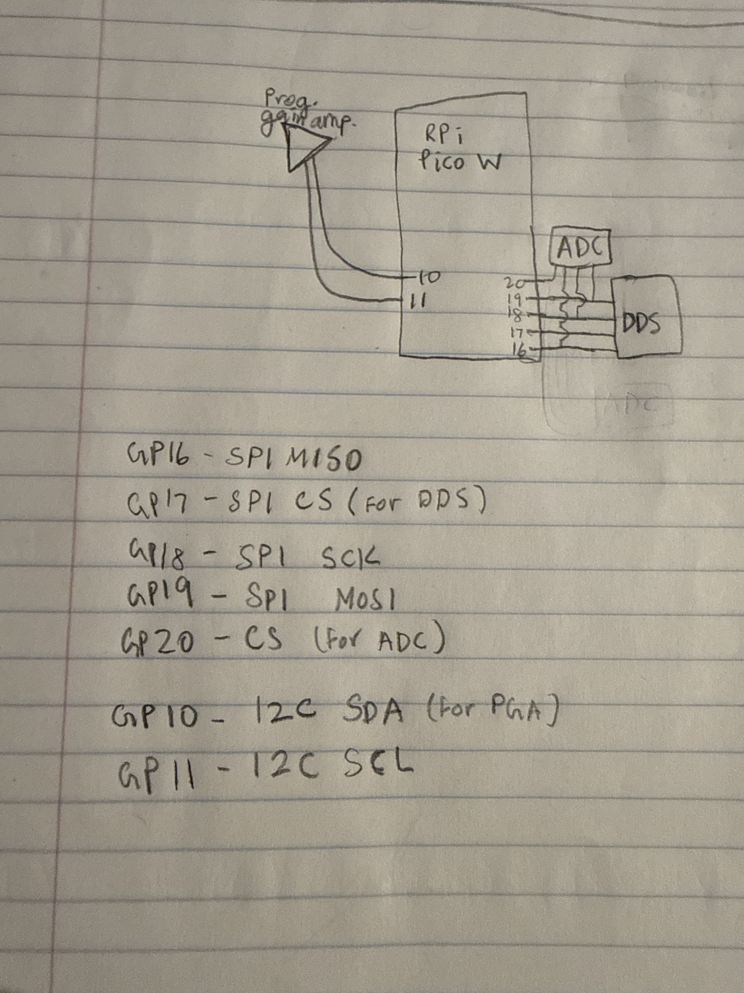
MCU Pinout
Don’t need many operations outside of communicating with peripherals.

Slide 5
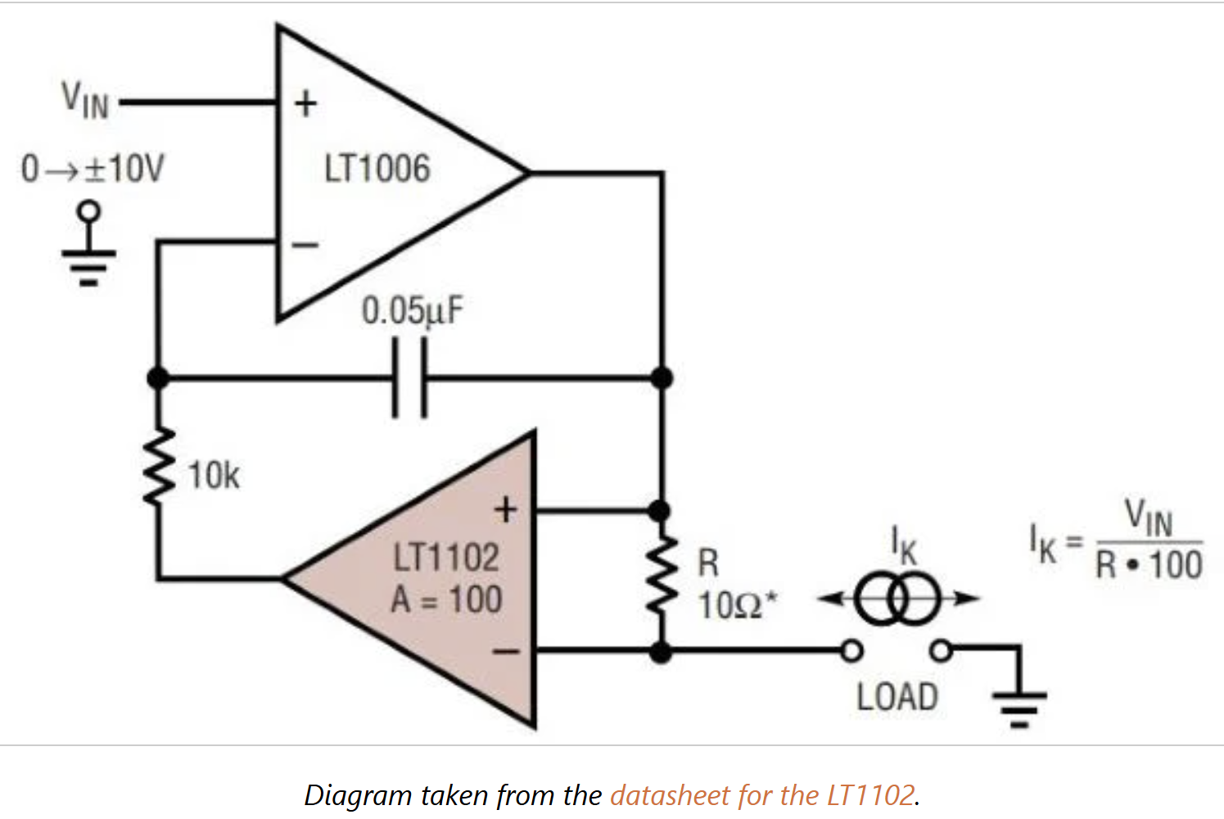
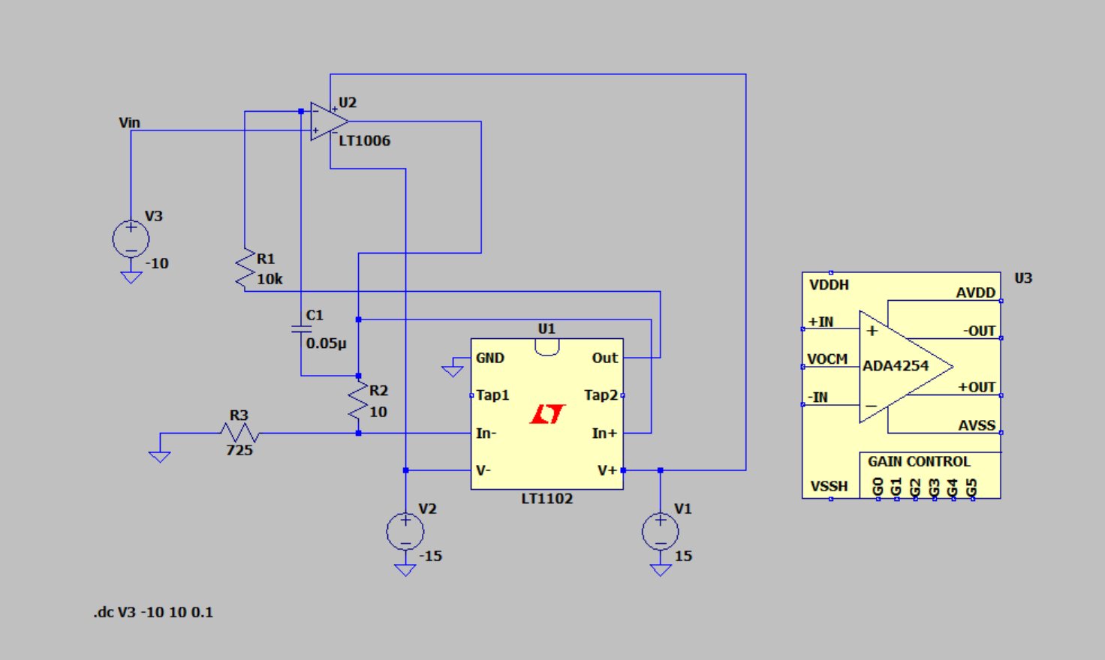
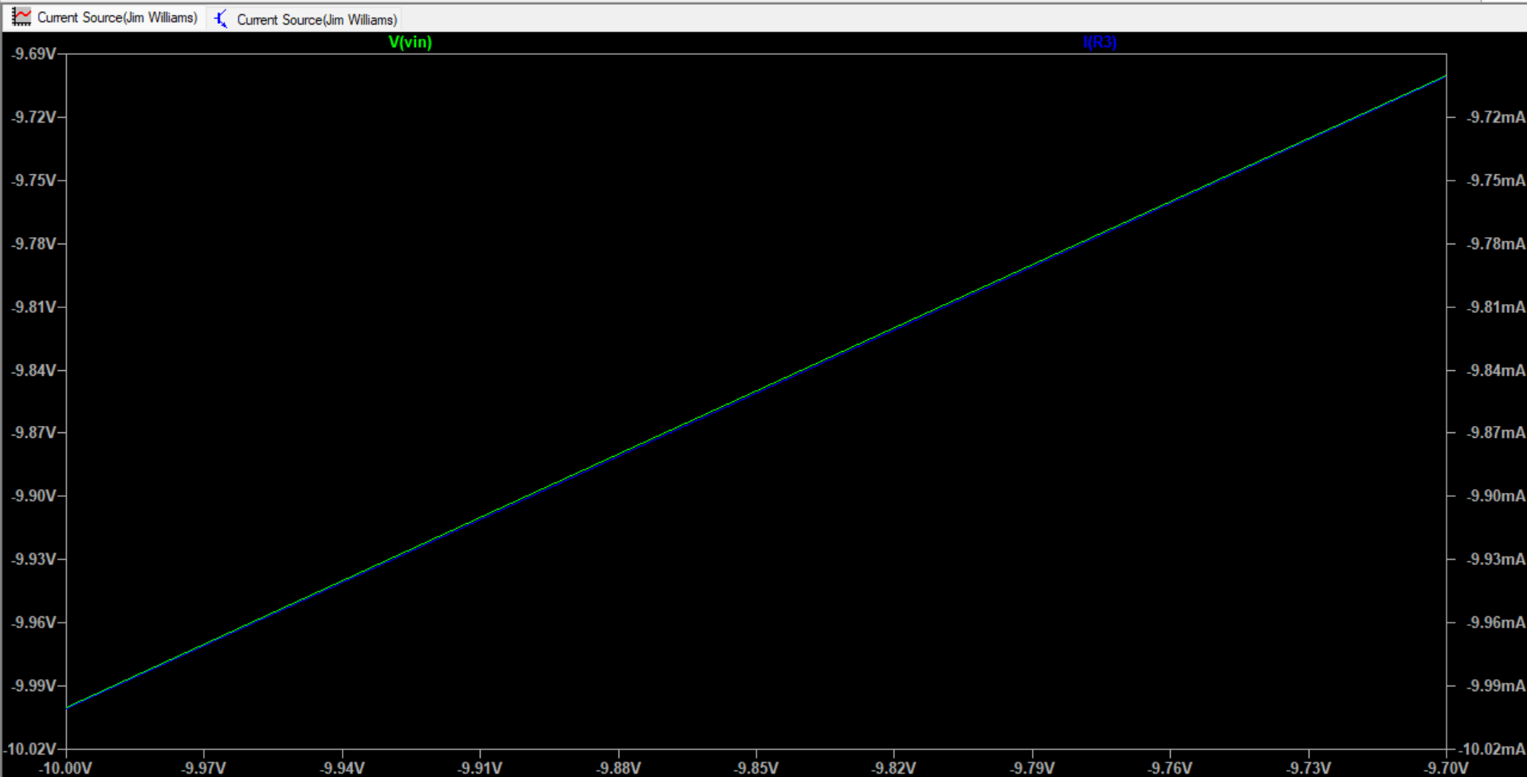
Working Current Source
Need to figure out better op amps for higher load
Max load resistance right now is around 725Ohms

Slide 6
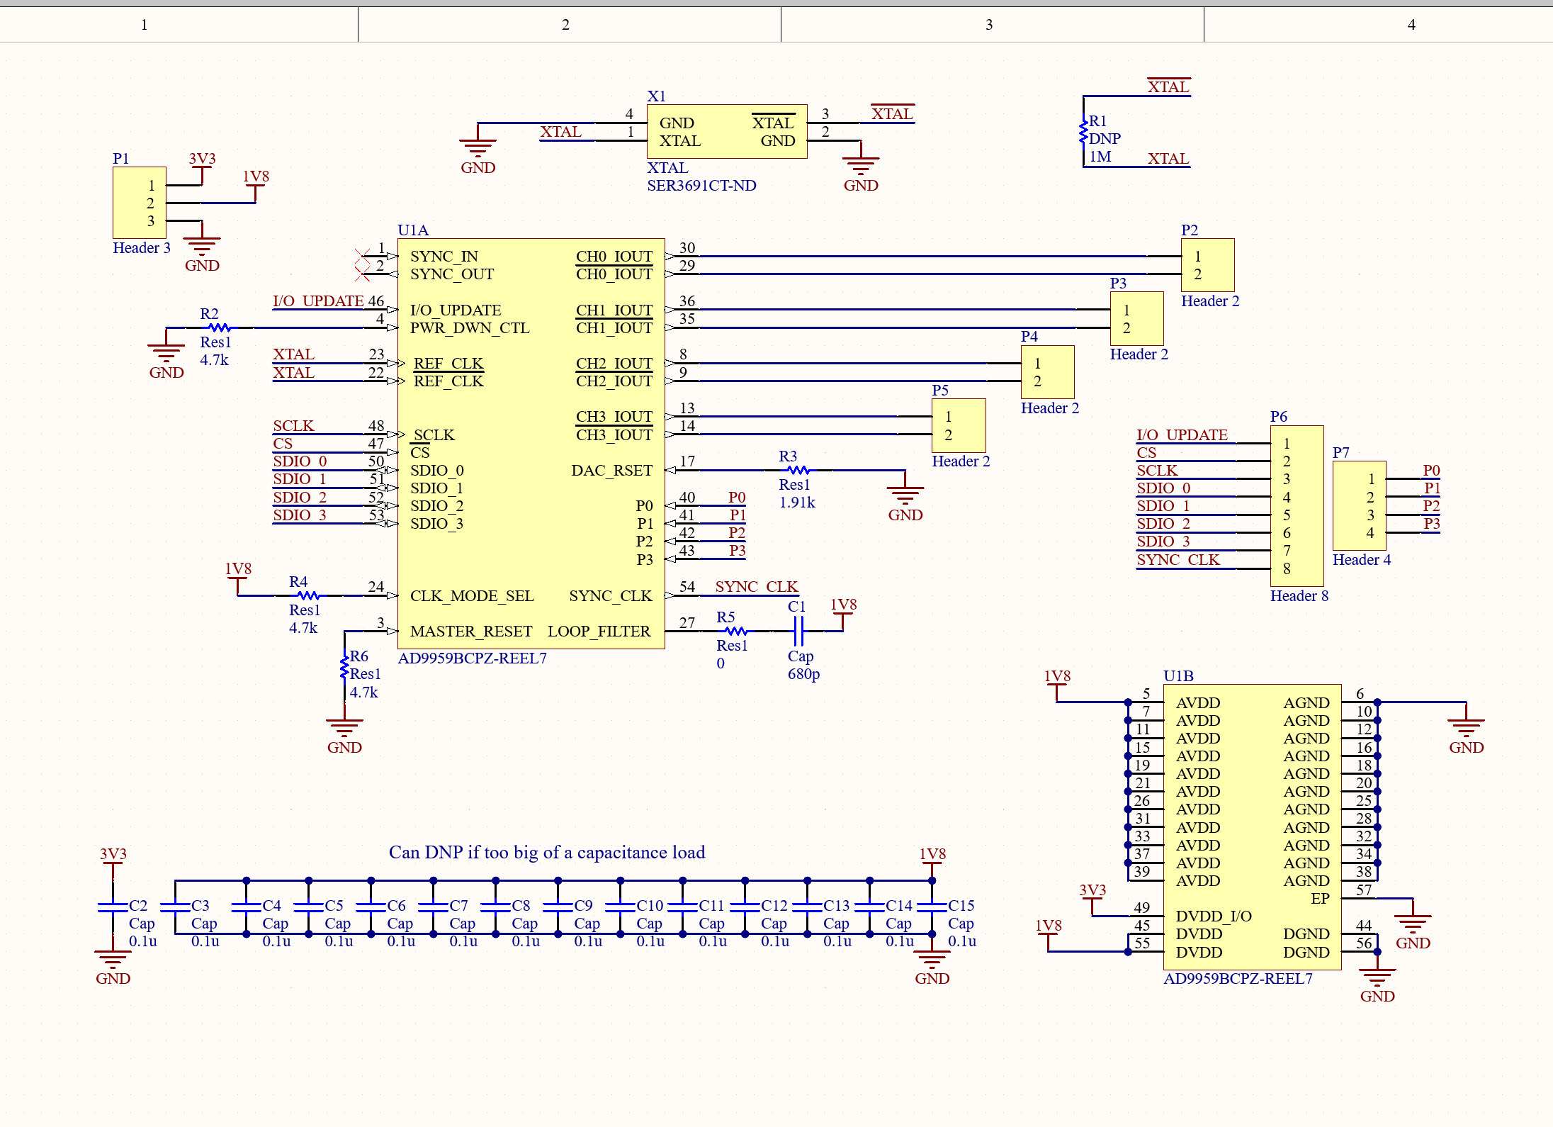
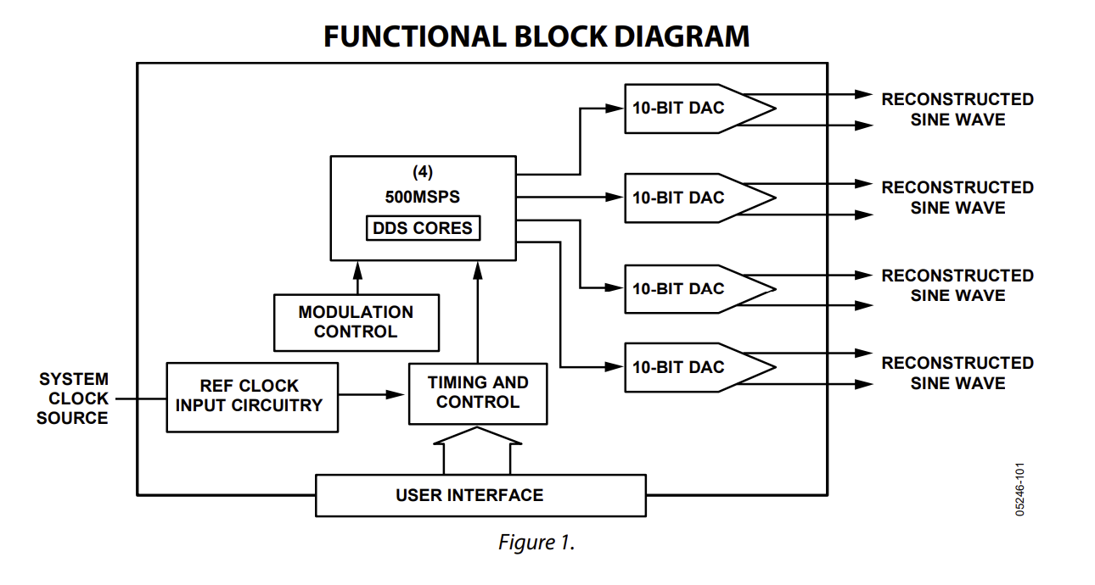
DDS Module

Slide 7
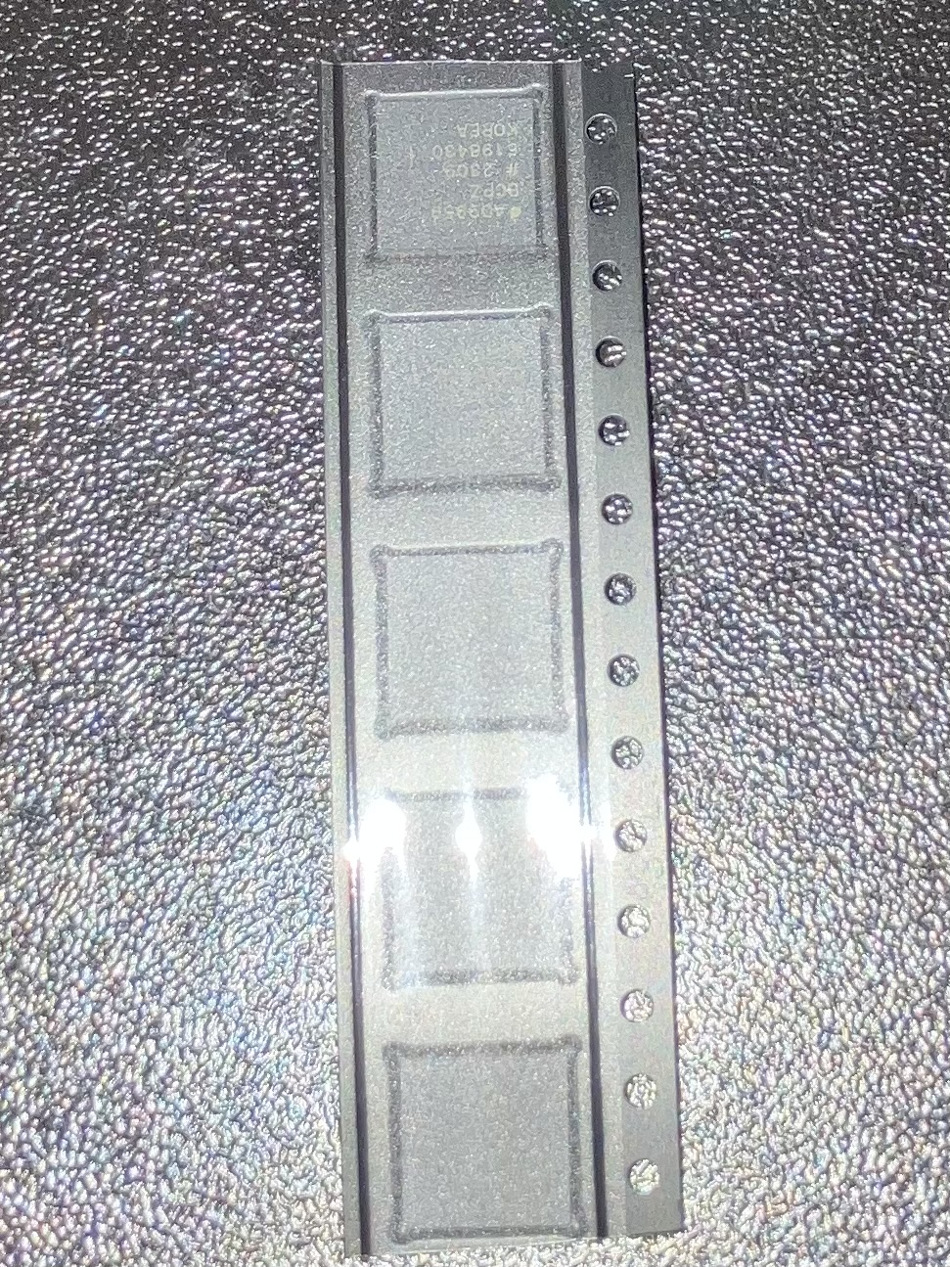
DDS Module

Slide 8
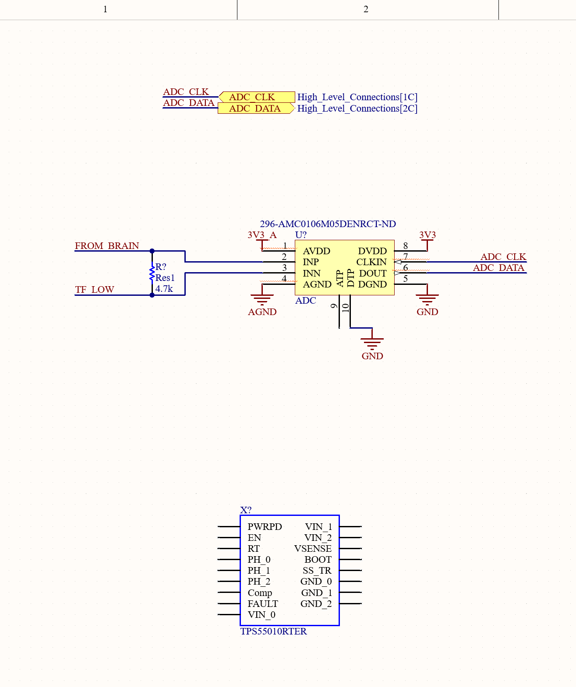
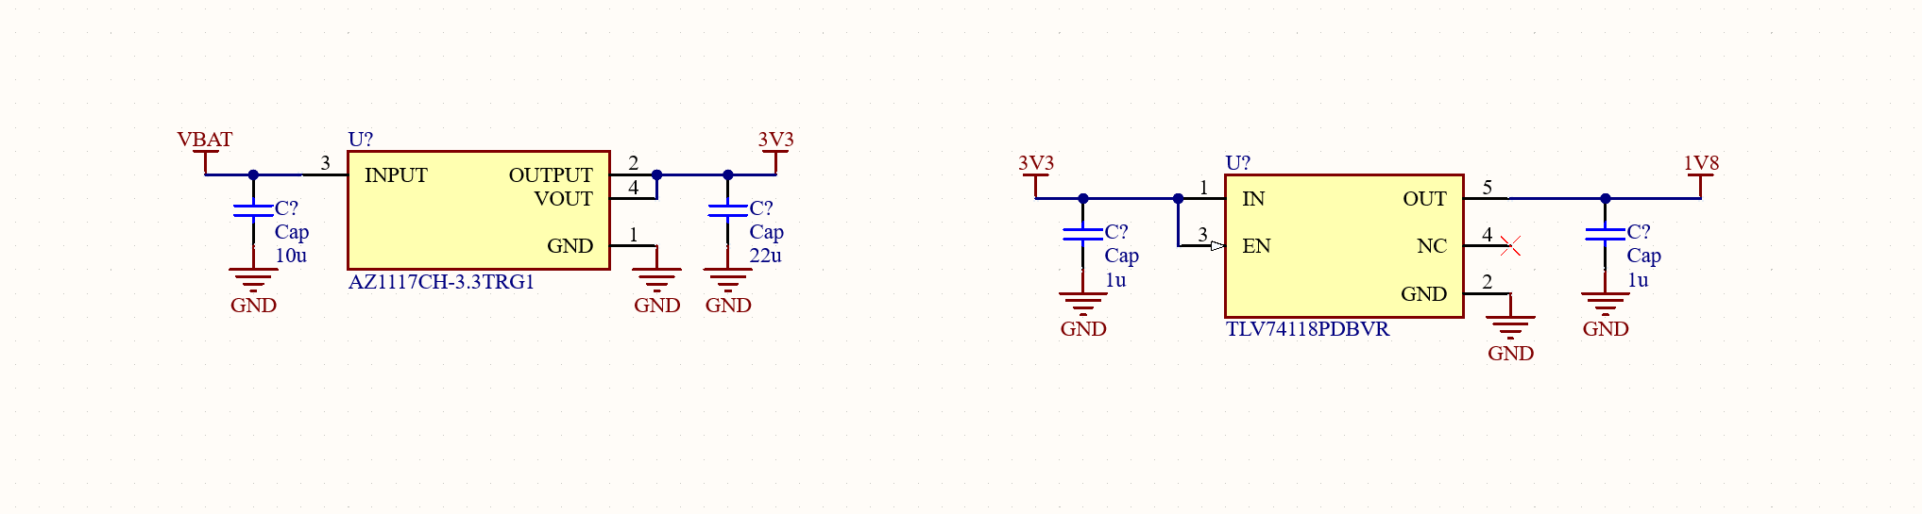
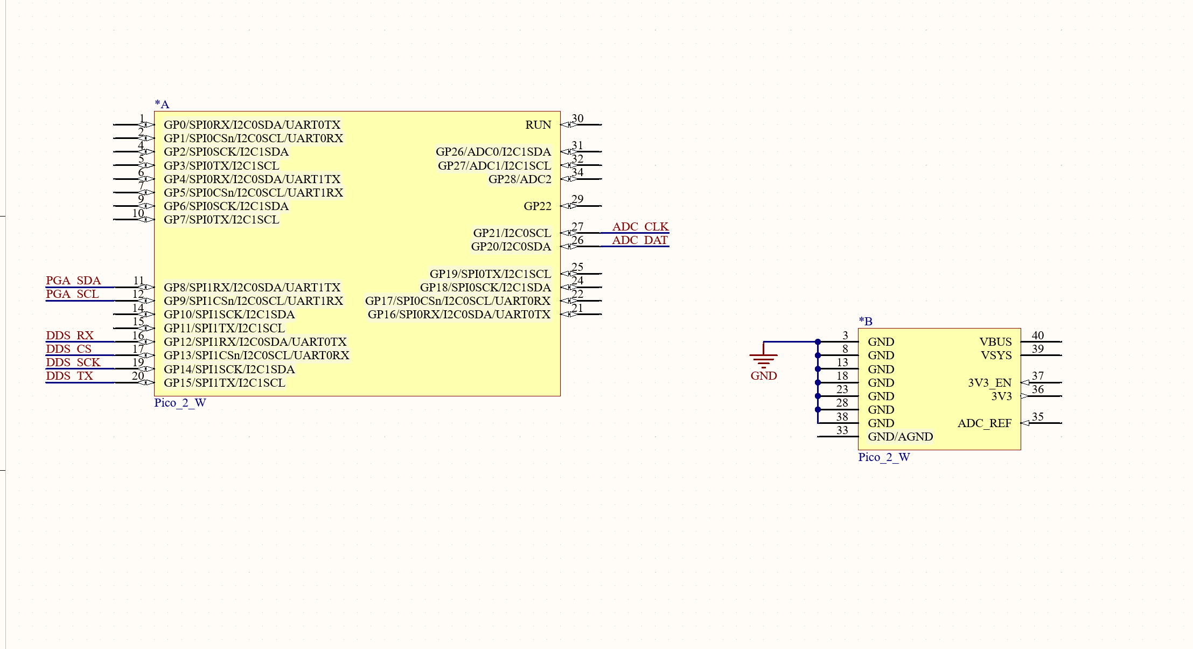
Schematic Updates

Slide 9
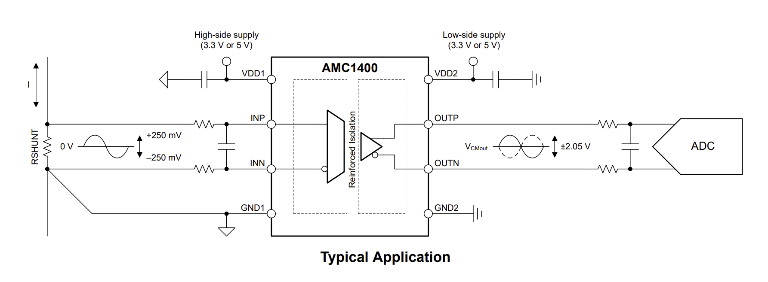
ADC
Need isolation for safety
Should be able to communicate with MCU directly

Slide 10
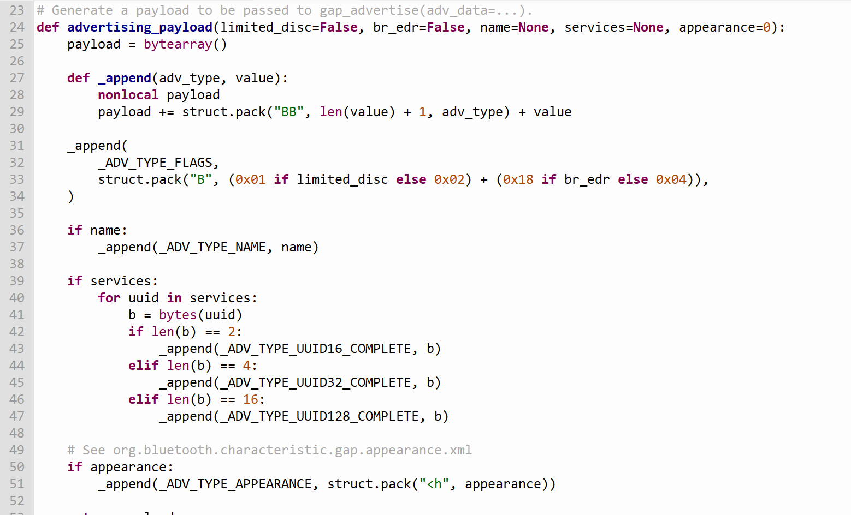
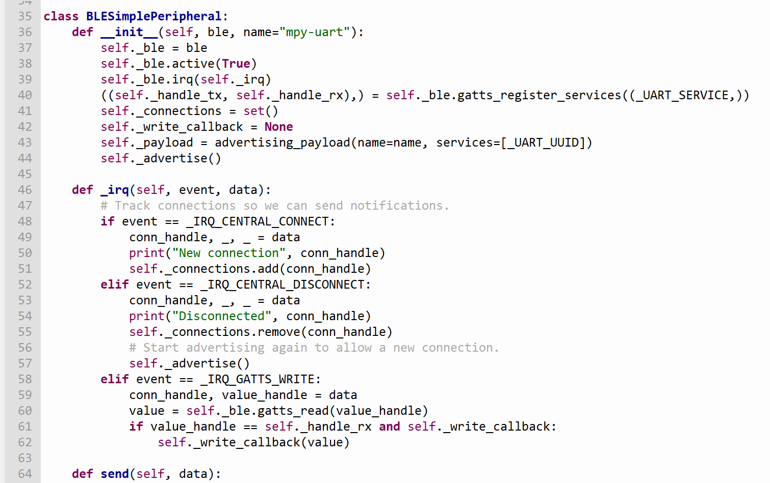
Bluetooth Connection to the MCU (Raspberry pi Pico W)
Save two MicroPython modules in our RPi Pico to communicate via Bluetooth Low Energy
Helpers for generating BLE advertising payloads
Creates a simple BLE peripheral
https://electrocredible.com/raspberry-pi-pico-w-bluetooth-ble-micropython/

Slide 11
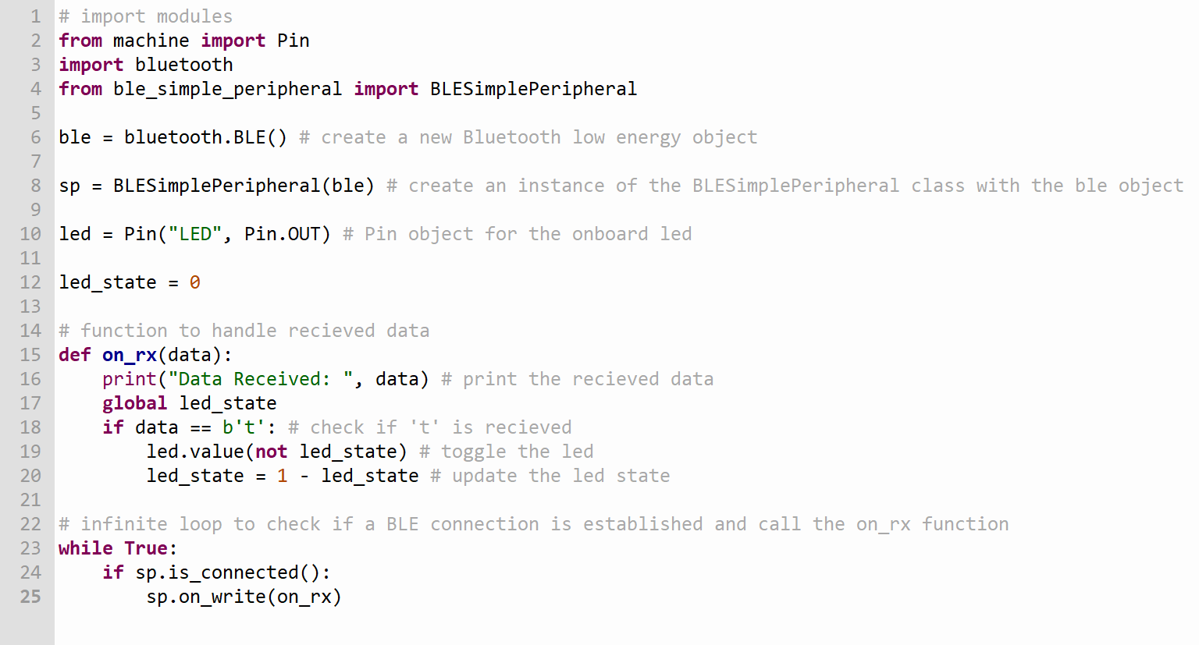
Bluetooth Connection to the MCU (Raspberry pI Pico W)
Code to control the onboard led with a Bluetooth terminal on phone

Slide 12
Plans for Isolation
Use isolated amplifier through a transformer
Read output current and use a control loop to monitor and adjust output

Slide 13
Plans for Battery
Calculate required amp hours to narrow search
Find something with integrated BMS

Slide 14
Challenges so far
Height limit with isolation transformers
Current source circuitry

Slide 15
Immediate Plan
Continue schematic and symbol creation
Find battery for device
Find components for Jim Williams source that handle high voltage and simulate
Determine board measurements for housing

Slide 16
Questions/Feedback

